Slide 1

MUSIC STORE DATA ANALYSIS
Presented By
Name : K Tejaswi
Batch : 493

Slide 2
About me
MBA in Finance from MLR Institute of Technology and B.Sc. in Computer Science from Nizam College.
Currently pursuing Data Analytics training at Innomatics Research Labs.
Background
Why you want to learn Data Analytics
Share your LinkedIn and GitHub profile URLs
Passionate about transforming data into meaningful insights.
Interested in combining analytical, technical, and business skills to support data-driven decision-making.
LinkedIn: https://www.linkedin.com/in/k-tejaswi-2a4703398
GitHub: https://github.com/Tejaswi-k8912

Slide 3
Agenda
Business Problem
Database Schema & Relationships
Data Import Process
Analysis & Queries
Key Findings
Recommendations
Conclusion

Slide 4
Business Problem
Business Problem Statement
The music store collects large amounts of data related to customers, artists, albums, tracks, invoices, and sales transactions. However, raw data alone does not provide meaningful business insights.
The objective of this project is to analyze customer purchasing behavior, identify popular music genres and artists, understand sales performance, and extract actionable insights using SQL queries.
Business Questions Addressed
Who is the senior-most employee?
Which customers contribute the highest revenue?
What are the most popular music genres?
Which artists generate the highest sales?
How much do customers spend on different artists?
What are the top genres in each country?
Who is the top customer in each country?

Slide 5
Main Tables and Relationship Flow
Table | Purpose
Customer | Customer Information
Invoice | Purchase Transactions
Invoice line | Purchased Tracks
Track | Song Details
Album | Album Details
Artist | Artist Information
Genre | Music Categories
Customer
↓
Invoice
↓
Invoice Line
↓
Track
↓
Album
↓
Artist

Slide 6
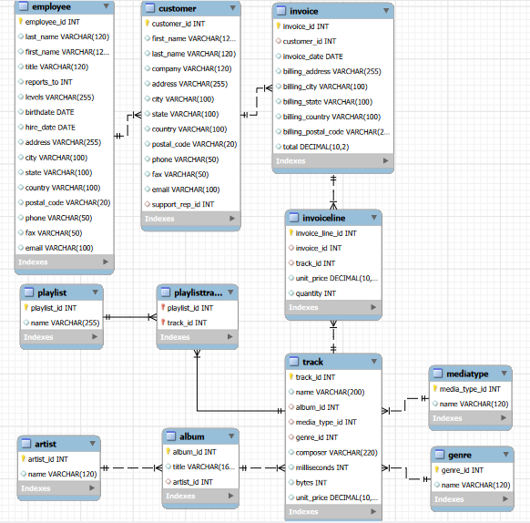
Database Schema

Slide 7
Data Import Process
Steps Performed
Created Music Store Database
Created all tables
Defined Primary Keys
Defined Foreign Keys
Imported CSV files
Tables Imported
Employee
Customer
Artist
Album
Genre
MediaType
Track
Invoice
InvoiceLine
Playlist
PlaylistTrack

Slide 8
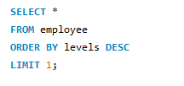
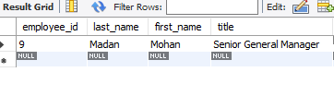
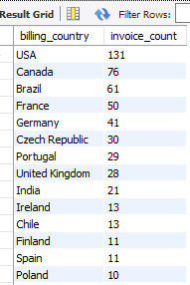
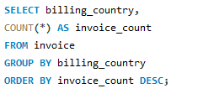
Queries and Analysis of the Data
Business Question
Who is the senior-most employee based on job title?
Business Question
What are the countries with most invoices?

Slide 9
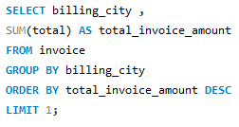

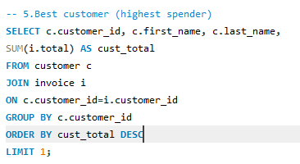

Business Question
What is the city with highest revenue?
Business Question
Who is the customer spent most on the music?

Slide 10
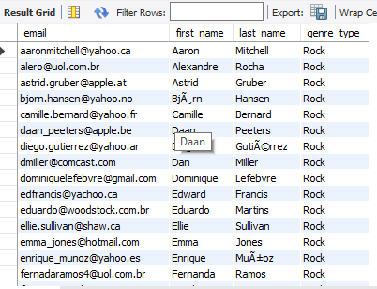
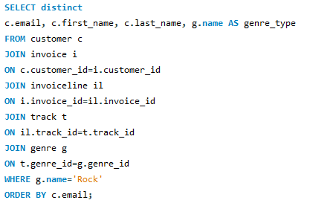
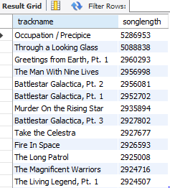

Business Question
All the customers who are ‘Rock’ music listeners?
Business Question
What are the tracks that are longer than the average song length?

Slide 11
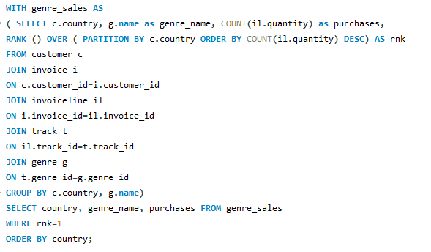
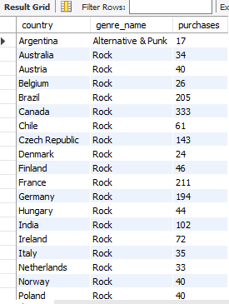
Business Question
What is the most popular genre for each country?

Slide 12
Key Findings
Rock genre dominates sales.
Certain customers contribute significantly to revenue.
Customer preferences differ by country.
Popular artists generate a major share of sales.
SQL joins help connect customer behavior with music preferences.

Slide 13
Recommendations.
Focus promotions on top-performing genres.
Develop artist-specific marketing campaigns.
Implement personalized music recommendations.
Use country-wise insights for targeted marketing.
Reward high-value customers through loyalty programs.
Promote emerging genres to increase catalog visibility.

Slide 14
Conclusion
The Music Store Data Analysis project successfully demonstrated how SQL can be used to transform raw transactional data into meaningful business insights. By analyzing customer purchases, artist performance, music genres, and sales trends, valuable patterns in customer behavior and revenue generation were identified.
Throughout the project, various SQL concepts such as joins, aggregate functions, subqueries, Common Table Expressions (CTEs), and window functions were applied to solve real-world business problems. The analysis helped identify top customers, popular genres, leading artists, and country-wise music preferences
Overall, this project strengthened practical database management and analytical skills while showcasing the importance of data-driven decision-making in the music retail industry. It provided hands-on experience in extracting actionable insights from relational databases using SQL.

Slide 15


Slide 16

THANK YOU

